Slide 1
Sensitivity Analysis & Probabilistic Analysis
Day 4

Slide 2
Agenda
Sensitivity analyses
Probabilistic analyses
Notes:
4

Slide 3
Sensitivity Analysis
Vary input parameters within plausible ranges
For which values is each strategy optimal?
Threshold analysis
Deterministic sensitivity analysis (DSA)
One-way analysis: vary one parameter, hold rest fixed
Two-way analysis: vary two parameters, hold rest fixed
Probabilistic sensitivity analysis (PSA)
Simultaneously vary input parameters by randomly sampling from appropriate probability distributions
How often is each alternative cost-effective?
What strategy has the highest expected net benefit
Notes:
4

Slide 4
Threshold Analysis

Slide 5
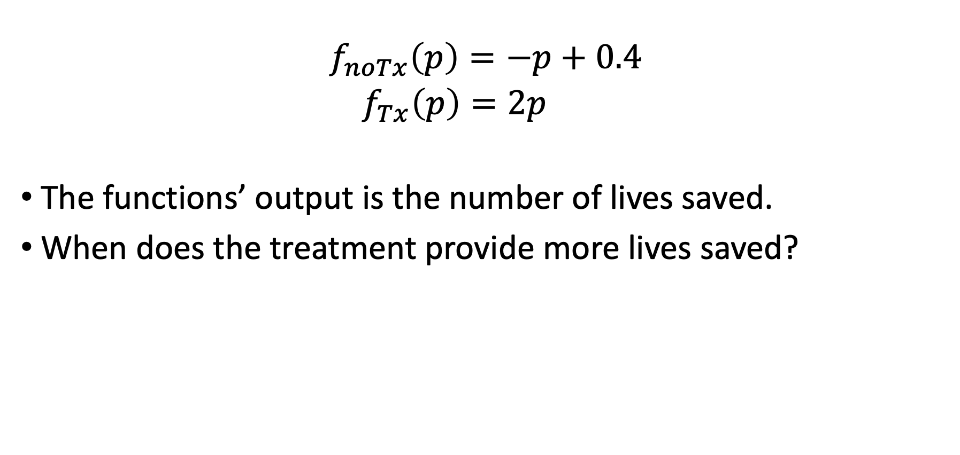
Simple Threshold Analysis
$$\begin{matrix}f_{noTx}\left(p\right)=−p+0.4 \\ f_{Tx}\left(p\right)=2p \end{matrix}$$
The functions’ output is the number of lives saved.
When does the treatment provide more lives saved?
* Assume the functions are actually max(f(p), 0) – they never go negative
Notes:
4

Slide 6
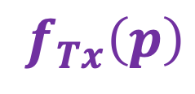
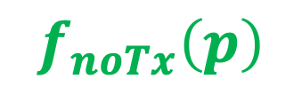
Simple threshold analysis
$$f_{Tx}\left(p\right)$$
LIVES
$$f_{noTx}\left(p\right)$$
p

Slide 7
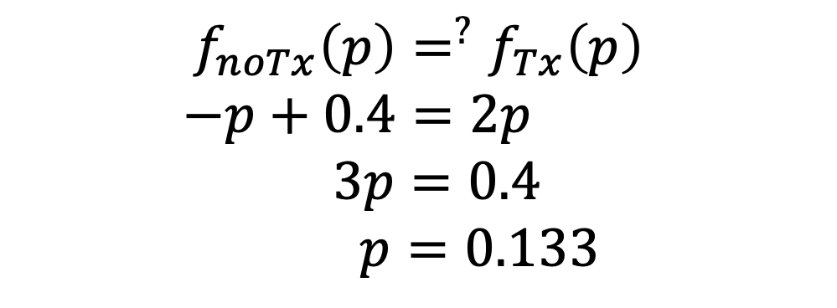

Simple threshold analysis
$$\begin{matrix}\begin{aligned}f_{noTx}\left(p\right)=^{?}f_{Tx}\left(p\right) \\ −p+0.4=2p \\ 3p=0.4 \end{aligned} \\ p=0.133 \end{matrix}$$
The threshold: $p=0.133$
MEANING: Point at which both give the same # of lives saved => We are indifferent between Tx’s

Slide 8
Simple threshold analysis
$$f_{Tx}\left(p\right)$$
LIVES
$$f_{noTx}\left(p\right)$$
0
0.133
0.4
p

Slide 9

Simple threshold analysis
$$f_{Tx}\left(p\right)$$
LIVES
In what range of $p$ is treatment better?
$$f_{noTx}\left(p\right)$$
0
0.133
0.4
p

Slide 10
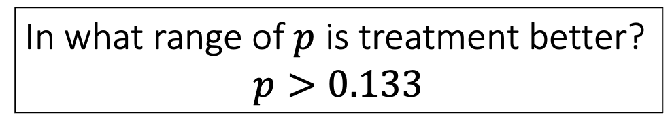
Simple threshold analysis
$$f_{Tx}\left(p\right)$$
LIVES
In what range of $p$ is treatment better?
$$p>0.133$$
$$f_{noTx}\left(p\right)$$
0
0.133
0.4
p

Slide 11
Aside: cost-effectiveness
The example had only 1 output
Benefit: measured in lives saved
What about cost-effectiveness?
Each function has two outputs: (costs and QALYs)
For each value of p, compute costs & QALYs
C_notx, Q_notx, C_tx, Q_tx
Assess dominance and compute ICERs
For example: assume C_tx > C_notx

Slide 12
Aside: cost-effectiveness
ICER
0
0.133
0.4
p

Slide 13
Aside: cost-effectiveness
ICER
0
0.133
0.4
p

Slide 14
Aside: cost-effectiveness
ICER
No Tx dominates
0
0.133
0.4
p

Slide 15
Aside: cost-effectiveness
ICER
No Tx dominates?
WHY?
0
0.133
0.4
p

Slide 16
Aside: cost-effectiveness
ICER
No Tx dominates?
HERE?
0
0.133
0.4
p

Slide 17
Aside: cost-effectiveness
ICER
No Tx dominates
Really low ICER
0
0.133
0.4
p

Slide 18
Aside: cost-effectiveness
But where do we shift to preferring Tx?
ICER
No Tx dominates
Really low ICER
0
0.133
0.4
p

Slide 19
Aside: cost-effectiveness
This depends on our willingness to pay (WTP) for QALYs
ICER
No Tx dominates
Really low ICER
0
0.133
0.4
p

Slide 20
Aside: cost-effectiveness
ICER
No Tx dominates
Really low ICER
WTP
0
0.133
0.4
p

Slide 21
Aside: cost-effectiveness
ICER
No Tx dominates
Tx dominates
WTP
0
0.133
0.4
p

Slide 22
Aside: cost-effectiveness
ICER
No Tx preferred
Tx preferred
WTP
0
0.133
0.4
p

Slide 23
Deterministic Sensitivity Analysis

Slide 24
One-Way Sensitivity Analysis (OWSA)
Systematically vary a single parameter over range of uncertainty, keeping all others fixed
p_PCed = 30%, p_PCed = 40%, p_PCed = 50%, etc…
For each parameter value, calculate the expected outcomes under each strategy
Identify which strategy is preferred for each parameter value
Notes:
4

Slide 25
One-Way Sensitivity Analysis (OWSA)
Probability of early detection (Primary care) | Deaths per 1,000
 | EV ‘Do Nothing’ | EV ‘Spray’ | EV ‘Test’
30% | 0.33 | 1.05 | 0.37
35% | 0.67 | 1.10 | 0.53
40% | 1.00 | 1.15 | 0.70
45% | 1.33 | 1.20 | 0.87
50% | 1.67 | 1.25 | 1.03
55% | 2.00 | 1.30 | 1.20
60% | 2.33 | 1.35 | 1.37
65% | 2.67 | 1.40 | 1.53

Slide 26
One-Way Sensitivity Analysis (OWSA)
Probability of early detection (Primary care) | Life Expectancy
 | Routine practice | Primary Care | Hospital Care
30% | 0.33 | 1.05 | 0.37
35% | 0.67 | 1.10 | 0.53
40% | 1.00 | 1.15 | 0.70
45% | 1.33 | 1.20 | 0.87
50% | 1.67 | 1.25 | 1.03
55% | 2.00 | 1.30 | 1.20
60% | 2.33 | 1.35 | 1.37
65% | 2.67 | 1.40 | 1.53

Slide 27
One-Way Sensitivity Analysis (OWSA)
Probability of early detection (Primary care) | Life Expectancy
 | Routine practice | Primary Care | Hospital Care
30% | 3.1 | 2.8 | 3.7
35% | 3.1 | 3.1 | 3.7
40% | 3.1 | 3.4 | 3.7
45% | 3.1 | 3.7 | 3.7
50% | 3.1 | 4.0 | 3.7
55% | 3.1 | 4.3 | 3.7
60% | 3.1 | 4.6 | 3.7
65% | 3.1 | 4.9 | 3.7

Slide 28
One-Way Sensitivity Analysis (OWSA)
Systematically vary a single parameter over range of uncertainty, keeping all others fixed
p.PCed = 30%, p.PCed = 40%, p.PCed = 50%, etc…
For each parameter value, calculate the expected outcomes under each strategy
Identify which strategy is preferred
‘Hospital Care’
‘Primary care’
30%
65%
Life Expectancy
= Base case

Slide 29
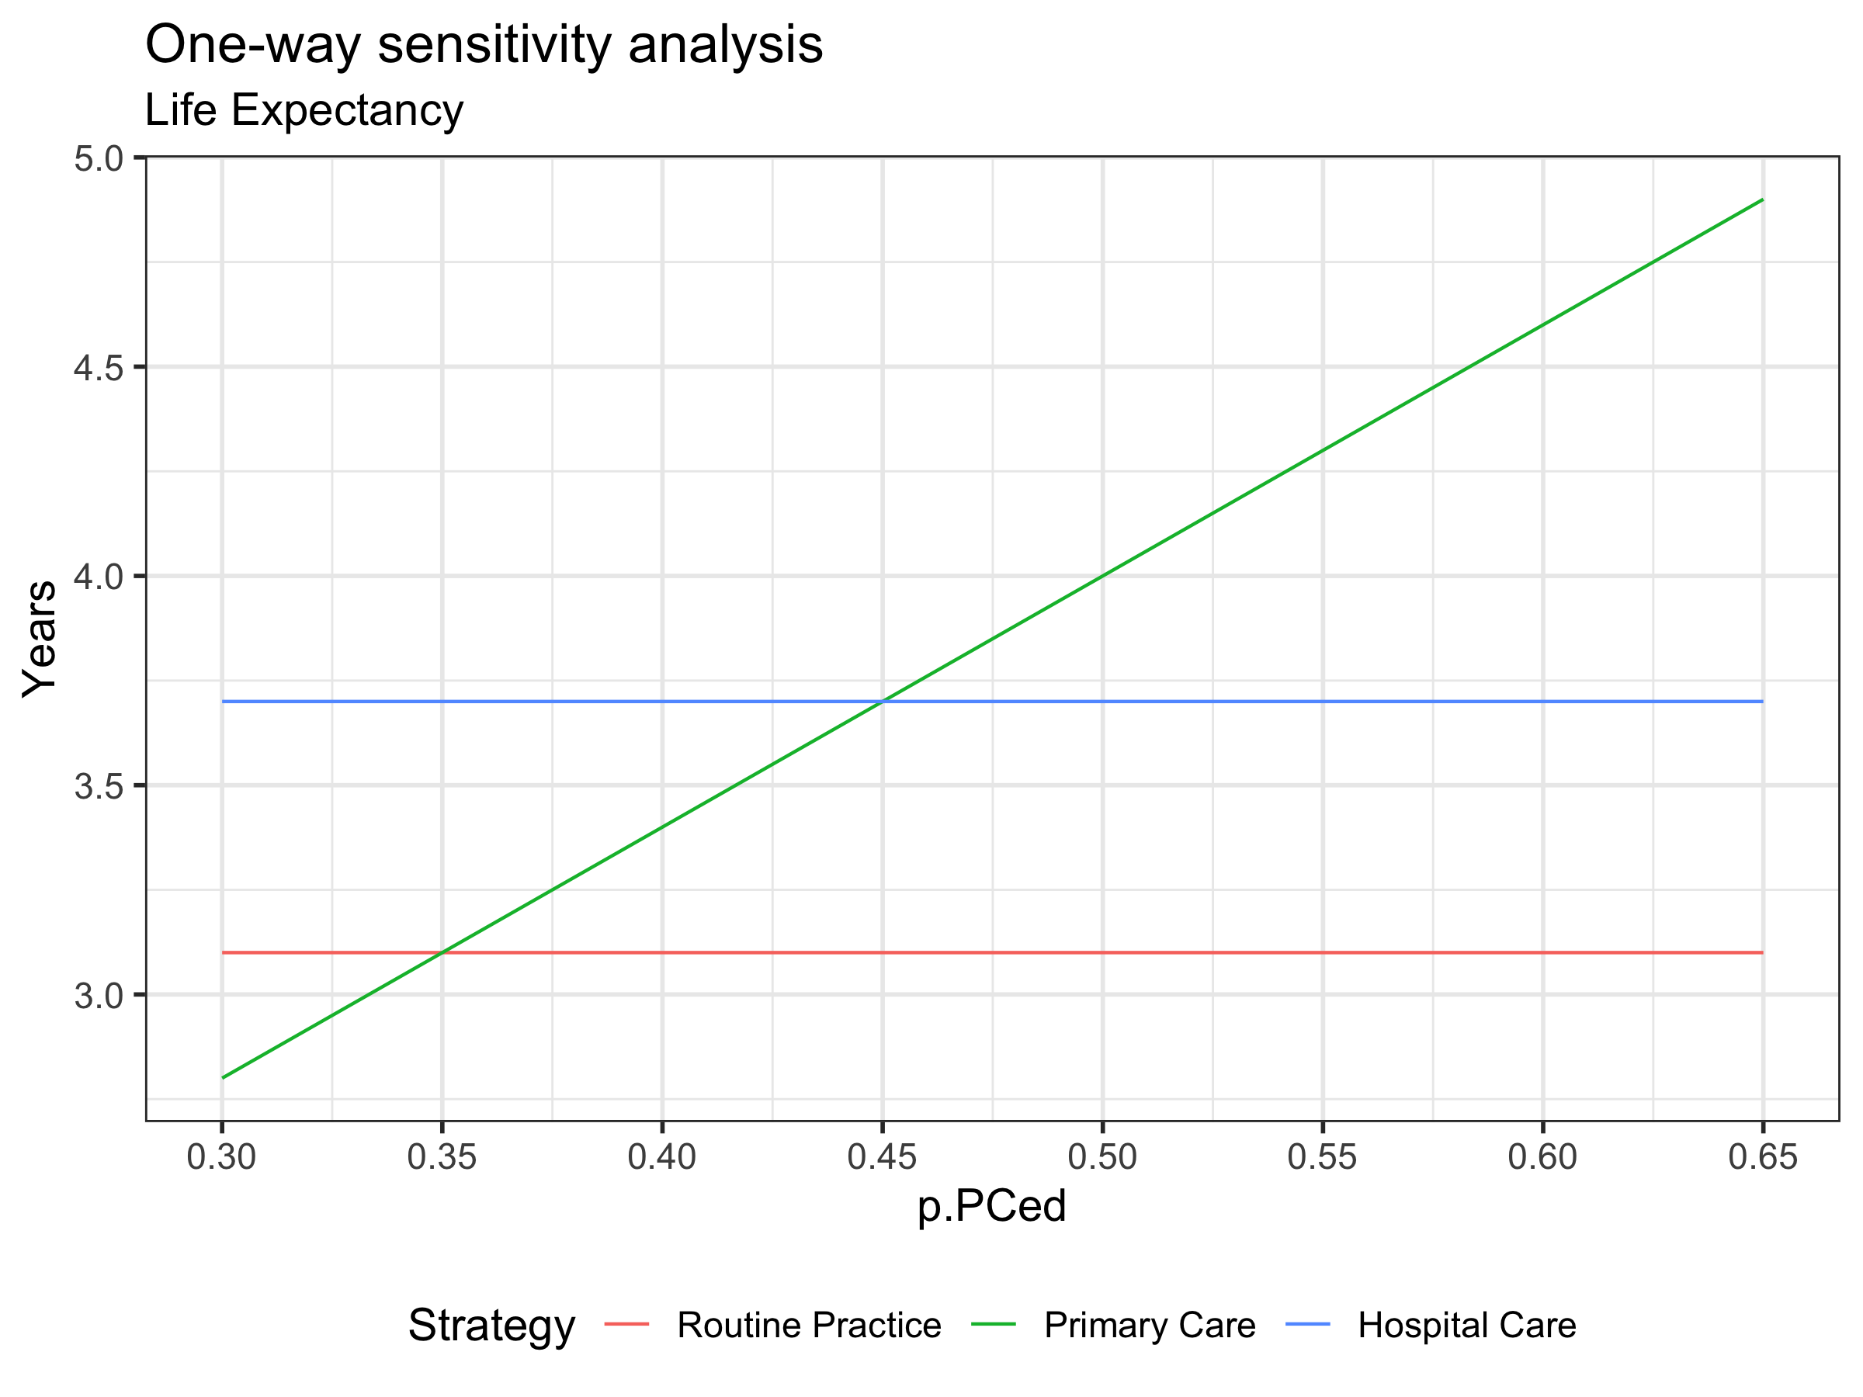
One-Way Sensitivity Analysis (OWSA)

Slide 30
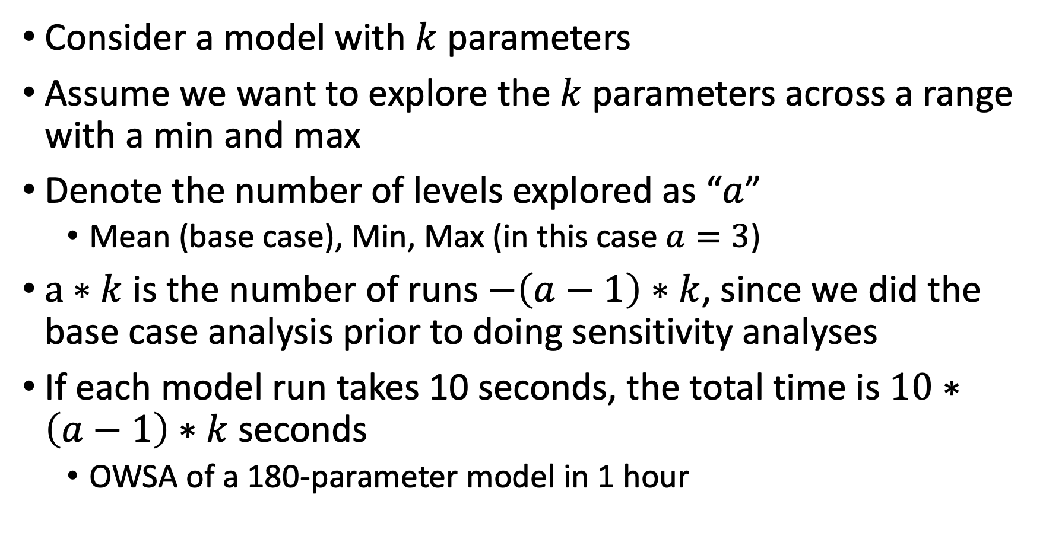
How many model runs?
Consider a model with $k$ parameters
Assume we want to explore the $k$ parameters across a range with a min and max
Denote the number of levels explored as “$a$”
Mean (base case), Min, Max (in this case $a=3$)
$a∗k$ is the number of runs $−\left(a−1\right)∗k$, since we did the base case analysis prior to doing sensitivity analyses
If each model run takes 10 seconds, the total time is $10∗\left(a−1\right)∗k$ seconds
OWSA of a 180-parameter model in 1 hour

Slide 31
Two-Way Sensitivity Analysis (TWSA)
p2
p1

Slide 32
Two-Way Sensitivity Analysis (TWSA)
p2
p1

Slide 33
Two-Way Sensitivity Analysis (TWSA)
p2
p1

Slide 34
Two-Way Sensitivity Analysis (TWSA)
p2
No Tx preferred
Tx preferred
p1

Slide 35
Two-Way Sensitivity Analysis (TWSA)
p2
No Tx preferred
Tx preferred
p1
Combinations of parameters can matter!

Slide 36
Two-Way Sensitivity Analysis (TWSA)
Systematically vary two parameters over range of uncertainty, keeping all others fixed
p.PCed = 25%, p.HCed = 30%
p.PCed = 25%, p.HCed = 40%
p.PCed = 25%, p.HCed = 50%
p.PCed = 30%, p.HCed = 30%
p.PCed = 30%, p.HCed = 40%
etc…
Particularly useful if one parameter influences the impact of the other on the optimal decision

Slide 37
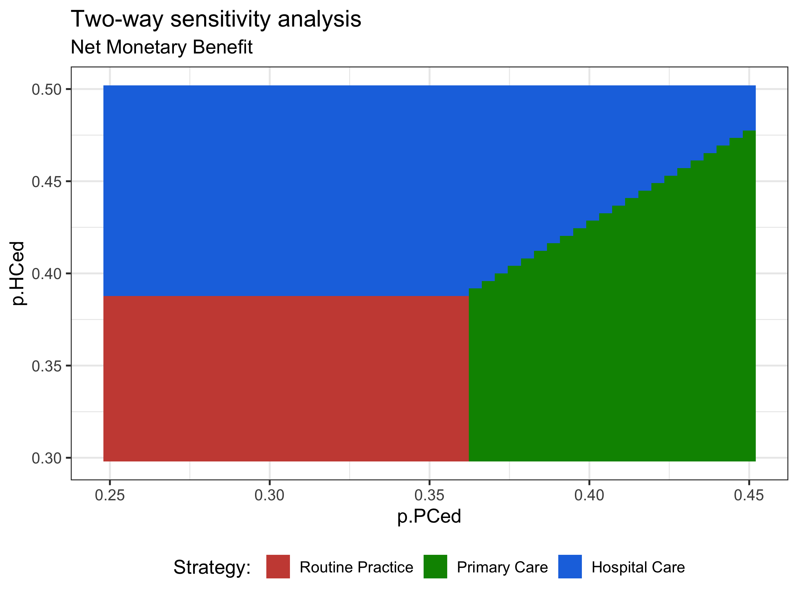
Two-Way Sensitivity Analysis (TWSA)

Slide 38
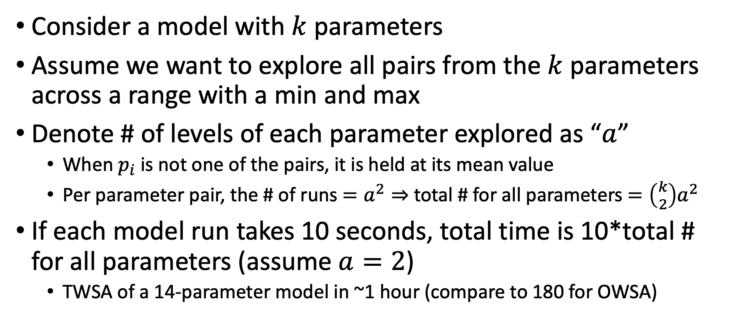
How many model runs?
Consider a model with $k$ parameters
Assume we want to explore all pairs from the $k$ parameters across a range with a min and max
Denote # of levels of each parameter explored as “$a$”
When $p_{i}$ is not one of the pairs, it is held at its mean value
Per parameter pair, the # of runs $=a^{2}⇒$ total # for all parameters $=\left({k \atop 2}\right)a^{2}$
If each model run takes 10 seconds, total time is 10*total # for all parameters (assume $a=2$)
TWSA of a 14-parameter model in ~1 hour (compare to 180 for OWSA)

Slide 39
The question we are answering
What is the marginal change in our outcome, due to a change in our parameter(s) (the ones being explored with the sensitivity analysis), if all others held at their base-case levels
This does not say anything about what the marginal change would look like if our other parameters took on some other value

Slide 40
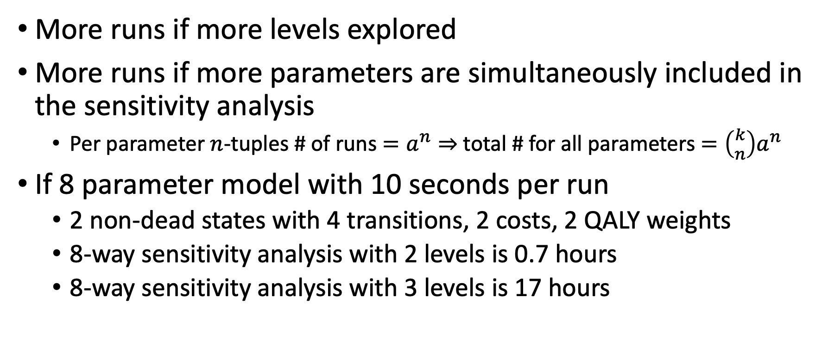
N-way sensitivity analysis
More runs if more levels explored
More runs if more parameters are simultaneously included in the sensitivity analysis
Per parameter $n$-tuples # of runs $=a^{n}⇒$ total # for all parameters $=\left({k \atop n}\right)a^{n}$
If 8 parameter model with 10 seconds per run
2 non-dead states with 4 transitions, 2 costs, 2 QALY weights
8-way sensitivity analysis with 2 levels is 0.7 hours
8-way sensitivity analysis with 3 levels is 17 hours

Slide 41
More efficient ways to explore uncertainty…
Design of experiments (fractional design) and Morris’s method
R.J. Duintjer Tebbens et al.
A k-way sensitivity analysis (k is the total # of parameters in the model) is a “design of experiments” or full factorial approach
The fractional design really means, that instead of doing all levels^k possible combinations of parameters, we sample at random X% of these combinations and simulate those
Random sampling gives us the general shape with some error due to sampling (which is hopefully small!)

Slide 42
Some parameter combinations more likely than others…
p2
p1

Slide 43
R session

Slide 44
Probabilistic Sensitivity Analysis

Slide 45
Definitions
Stochastic uncertainty: random variability between identical individuals
Parameter uncertainty: inadequate knowledge about a parameter value
Heterogeneity: variability between individuals that can be attributed to individual characteristics
Structural uncertainty: From model assumptions
Notes:
4

Slide 46
Parameter Uncertainty
Accounts for the likelihood of the values of each of the inputs and their effect on the model outputs
Parameters have distributions
Distributions of inputs reflect current knowledge of the parameters
Notes:
4

Slide 47
Parameter Uncertainty
Parameter Uncertainty
Rates
Probabilities
Effectiveness
Costs
Model Structure and Process Uncertainty
Alternative Assumptions
Notes:
4

Slide 48
Steps of a Probabilistic Sensitivity Analysis
Identify sources of parameter uncertainty
Characterize uncertain parameters as probability distributions
Define correlations as appropriate:
Patient-level data
Use of regression methods
Propagate uncertainty through model using second-order Monte Carlo simulation to describe uncertainty in the modeled outcomes

Slide 49
Frequentist vs. Bayesian Approach
Suppose you want to detect a treatment effect (i.e., difference of two proportions δ > 0)
Collect data sample
Frequentists ask: Pr(Data | H₀: δ=0)?
95% confidence interval of δ: [δ_{L}, δ_{U}]
Indirect probability statements
Notes:
4

Slide 50
An Alternative View
Bayesians: start with a prior “belief” about δ (prior distribution)
Then “update” the prior distribution with new information (ie, the data) to compute a posterior distribution
Bayesians ask: Pr(Hypothesis | Data)
Can collect more data if needed
Notes:
4

Slide 51
Prior Distribution
Pr(δ<0) = 50%

Slide 52
Posterior Distribution
Pr(δ<0) = 7%
[-0.023, 0.164]
“credible
interval”

Slide 53
The goal is to be able to make probabilistic statements such as:
The probability that the LE gain with medicine is greater than 0 is x%.
There is an 80% chance that the LE gain with medicine is between a years and b years (with 10% < a and 10% >b).
Notes:
4

Slide 54
Which Distributions To Use?
Beta (a, b)
values are between 0 and 1
shape is specified by two parameters, a and b
a = “number of successes” (or r)
a + b = “number of trials” (or n)
Lognormal (LN) (μ, σ)
values are greater than 0
values are positively skewed
Notes:
4

Slide 55
Some Data
Failure
Success
Medicine
a = 15
b = 85
n₁ = 100
Surgery
c = 5
d = 95
n₂ = 100
One option (assumes independence):
p_FailMed ~ Beta (a=15, b=85)
p_FailSurg ~ Beta (a=5, b=95)
Notes:
4

Slide 56
Some “Concerns”
“Linked” probabilities
p_FailMed and p_FailSurg are not independent
p_FailMed = rr_FailMed * p_FailSurg
Notes:
4

Slide 57
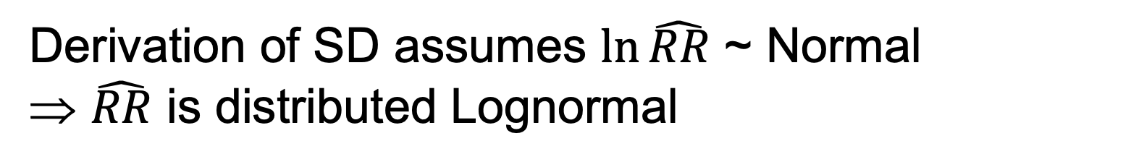
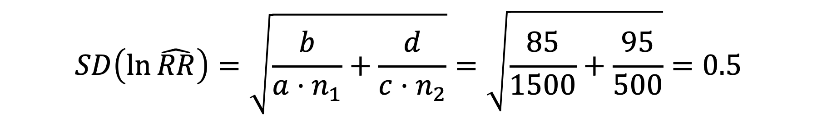

Linking probabilities through RR
$$\hat{RR}=\frac{0.15}{0.05}=3.0$$
$$SD\left(\ln{\hat{RR}}\right)=\sqrt{\frac{b}{a⋅n_{1}}+\frac{d}{c⋅n_{2}}}=\sqrt{\frac{85}{1500}+\frac{95}{500}}=0.5$$
95% confidence interval for $\hat{RR}$: $\left[1.13, 7.94\right]$
Derivation of SD assumes $\ln{\hat{RR}}$ ~ Normal
⇒ $\hat{RR}$ is distributed Lognormal
Notes:
4

Slide 58
Distribution for rr_FailMed
Goal: Find μ and σ of Lognormal distribution with correct mean (3.0) and 95% CI
Problem: If mean = 3.0 then confidence interval is off (shifted left); if confidence interval is correct then mean is not (3.39)
Notes:
4

Slide 59
Distributions in the Example
Variable Distribution Mean S.D.
p_FailSurg Beta (a=5, b=95) 0.05 0.02
p_FailMed Beta (a=15, b=85) 0.15 0.04
rr_FailMed LN (μ=0.97, σ=0.50) 3.0 1.60
mu_Fail LN (μ = -3.95, σ = 0.33) 0.02 0.007
*
Notes:
4

Slide 60
Method-of-Moments Fitting
From the data, get the mean and standard error
The mean and standard deviation of Beta distribution are a function of r and n (or a and b)
Solve for r and n (or a and b)
Notes:
4

Slide 61
Beta Density
Notes:
4

Slide 62
Lognormal Density

Slide 63
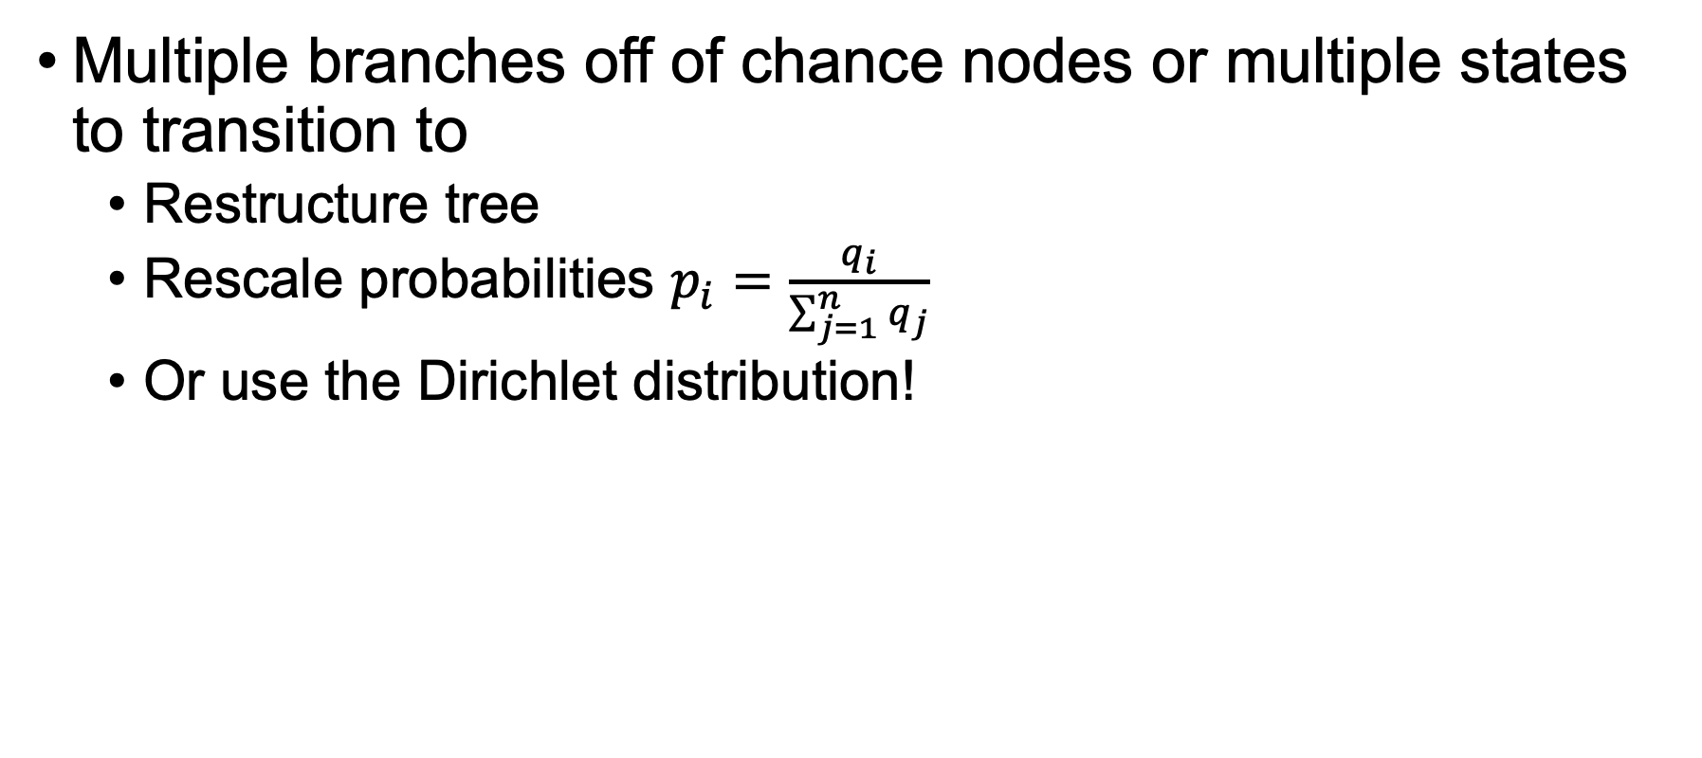
Additional “Concerns”
Multiple branches off of chance nodes or multiple states to transition to
Restructure tree
Rescale probabilities $p_{i}=\frac{q_{i}}{\sum_{j=1}^{n}{q_{j}}}$
Or use the Dirichlet distribution!
Briggs, A. H., Ades, A. E., & Price, M. J. (2003). Probabilistic Sensitivity Analysis for Decision Trees with Multiple Branches: Use of the Dirichlet Distribution in a Bayesian Framework. Medical Decision Making, 23(4), 341–350. https://doi.org/10.1177/0272989X03255922
Notes:
4

Slide 64
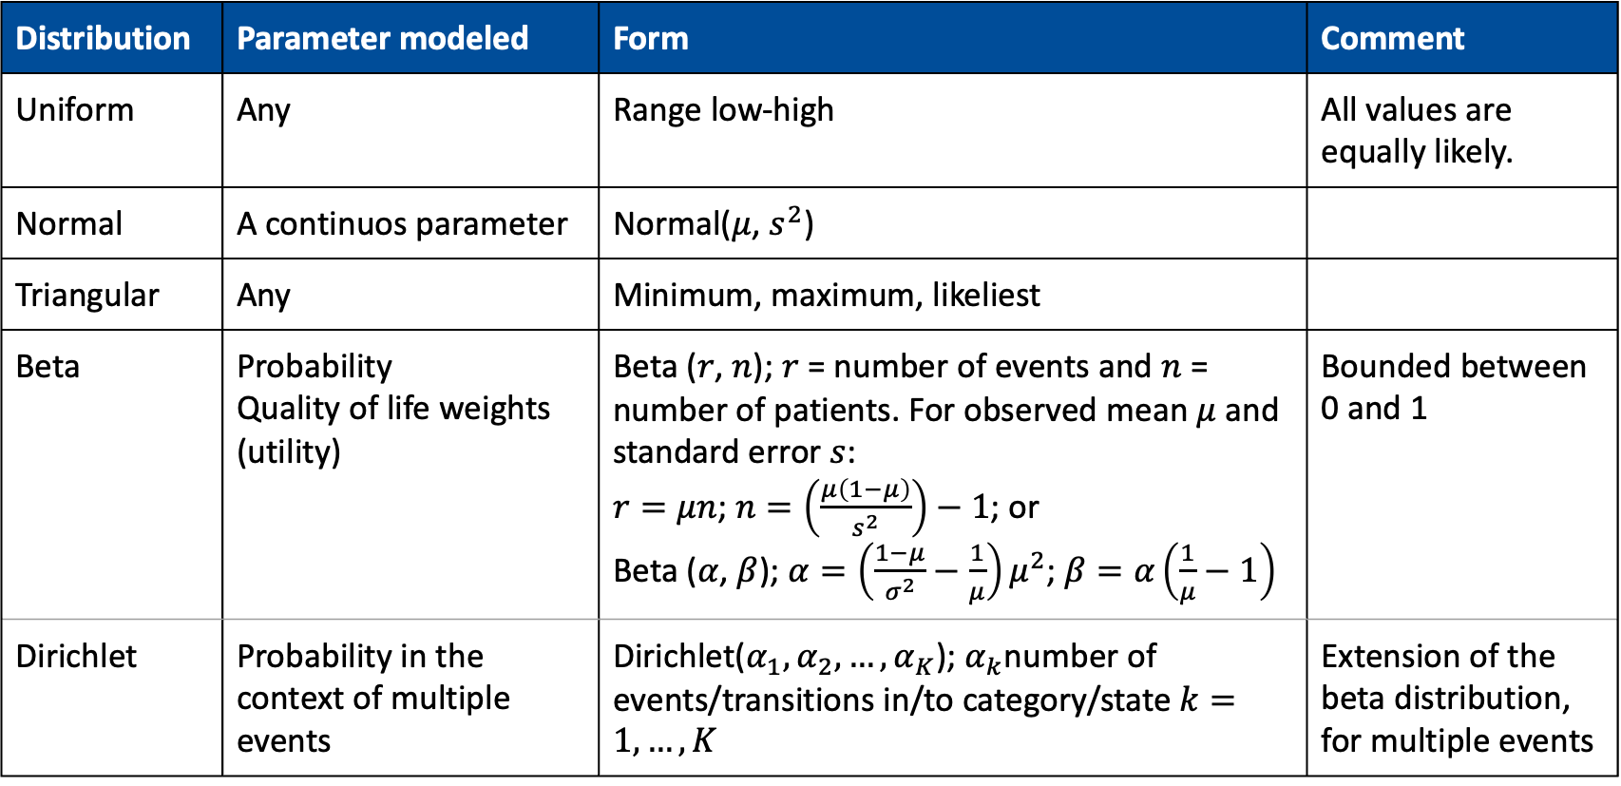
Distributions
Distribution | Parameter modeled | Form | Comment
Uniform | Any | Range low-high | All values are equally likely.
Normal | A continuos parameter | Normal($μ$, $s^{2}$)
Triangular | Any | Minimum, maximum, likeliest
Beta | Probability Quality of life weights (utility) | Beta ($r$, $n$); $r$ = number of events and $n$ = number of patients. For observed mean $μ$ and standard error $s$: $r=μn$;$n=\left(\frac{μ\left(1−μ\right)}{s^{2}}\right)−1$; or Beta ($α$, $β$); $α=\left(\frac{1−μ}{σ^{2}}−\frac{1}{μ}\right)μ^{2}$; $β=α\left(\frac{1}{μ}−1\right)$ | Bounded between 0 and 1
Dirichlet | Probability in the context of multiple events | Dirichlet($α_{1},α_{2},…,α_{K}$); $α_{k}$number of events/transitions in/to category/state $k=1,…,K$ | Extension of the beta distribution, for multiple events
Hunink MGM, Weinstein MC, Wittenberg E, Drummond MF, Pliskin JS, Wong JB, Glasziou PP. Decision Making in Health and Medicine: Integrating Evidence and Values. Cambridge University Press, Cambridge, UK, 2014. ISBN 978-1-107-69047-9. Table 12.2, page 371
Notes:
Commonly used distribution to model parameter uncertainty

Slide 65
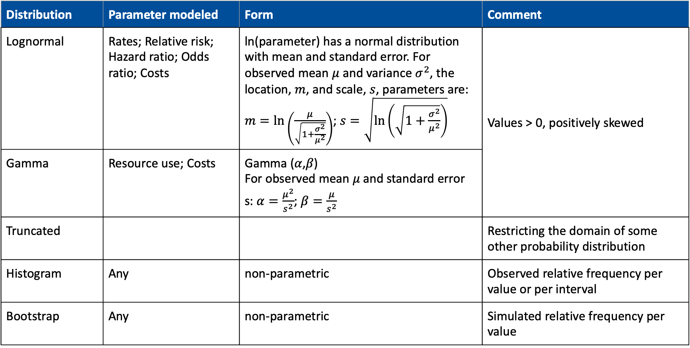
Distributions II
Distribution | Parameter modeled | Form | Comment
Lognormal | Rates; Relative risk; Hazard ratio; Odds ratio; Costs | ln(parameter) has a normal distribution with mean and standard error. For observed mean $μ$ and variance $σ^{2}$, the location, $m$, and scale, $s$, parameters are: $m=\ln\left(\frac{μ}{\sqrt{1+\frac{σ^{2}}{μ^{2}}}}\right)$; $s=\sqrt{\ln\left(\sqrt{1+\frac{σ^{2}}{μ^{2}}}\right)}$ | Values > 0, positively skewed
Gamma | Resource use; Costs | Gamma (𝛼,𝛽) For observed mean 𝜇 and standard error s:$α=\frac{μ^{2}}{s^{2}}$;$β=\frac{μ}{s^{2}}$ | Values >0, positively skewed
Truncated |  |  | Restricting the domain of some other probability distribution
Histogram | Any | non-parametric | Observed relative frequency per value or per interval
Bootstrap | Any | non-parametric | Simulated relative frequency per value
Notes:
Hunink MGM, Weinstein MC, Wittenberg E, Drummond MF, Pliskin JS, Wong JB, Glasziou PP. Decision Making in Health and Medicine: Integrating Evidence and Values. Cambridge University Press, Cambridge, UK, 2014. ISBN 978-1-107-69047-9. Table 12.2, page 371

Slide 66
PSA in R
Common naming structure among (most) distributions in R
“q”+ dist. (e.g. qnorm()): quantile function
“d”+ dist.(e.g. dnorm()): density function
“p”+ dist.(e.g. pnorm()): c.d.f function
“r” + dist.(e.g. rnorm()): random number generating function
sample():Random number sampling with(out) replacement and weights (e.g. for bootstrapping)
Notes:
4

Slide 67
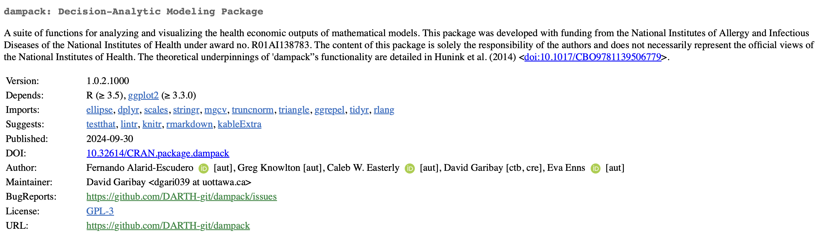
Resources for PSA in R: dampack package
# Install the release version from CRAN
install.packages("dampack")
# Install the development version from GitHub
devtools::install_github("DARTH-git/dampack")
Notes:
4

Slide 68
Mean of Ratios or Ratio of Means?
For each simulation calculate ΔC/ΔE and then average over all simulations (mean of ratios)
Average ΔC and ΔE separately over all simulations and then create the ΔC/ΔE ratio (ratio of means)
Stinnett & Paltiel 1997
Notes:
4

Slide 69
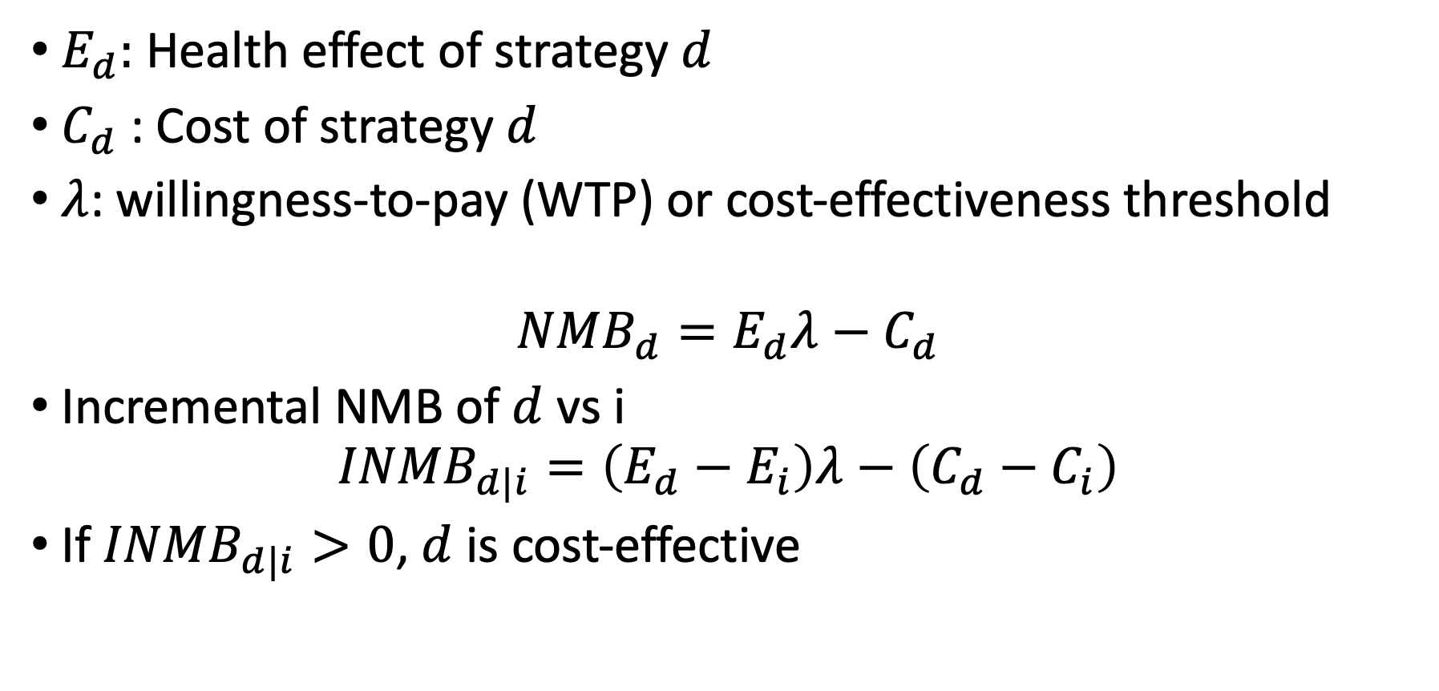
Net Monetary Benefit (NMB)
$E_{d}$: Health effect of strategy $d$
$C_{d}$ : Cost of strategy $d$
$λ$: willingness-to-pay (WTP) or cost-effectiveness threshold
$${NMB}_{d}=E_{d}λ−C_{d}$$
Incremental NMB of $d$ vs i
$${INMB}_{d|i}=\left(E_{d}−E_{i}\right)λ−\left(C_{d}−C_{i}\right)$$
If ${INMB}_{d|i}>0$, $d$ is cost-effective
Stinnett AA, Mullahy J. Net health benefits: a new framework for the analysis of uncertainty in cost-effectiveness analysis. Med Decis Making. 1998 Apr-Jun;18(2 Suppl):S68-80.
Notes:
4

Slide 70
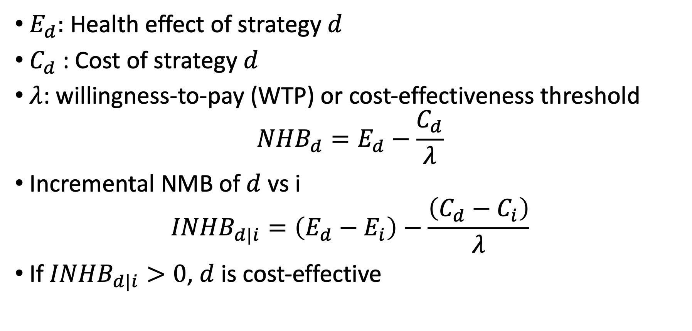
Net Health Benefit (NHB)
$E_{d}$: Health effect of strategy $d$
$C_{d}$ : Cost of strategy $d$
$λ$: willingness-to-pay (WTP) or cost-effectiveness threshold
$${NHB}_{d}=E_{d}−\frac{C_{d}}{λ}$$
Incremental NMB of $d$ vs i
$${INHB}_{d|i}=\left(E_{d}−E_{i}\right)−\frac{\left(C_{d}−C_{i}\right)}{λ}$$
If ${INHB}_{d|i}>0$, $d$ is cost-effective
Notes:
4

Slide 71
Decision rule
For a given C/E threshold, the competing choice alternative with the greatest NHB (or NMB) is the most cost-effective option at that budget constraint.
Comparing NHB (or NMB) at a fixed C/E threshold is equivalent to applying the rule of selecting the largest competing alternative whose incremental C/E ratio is below the C/E threshold.
Notes:
4

Slide 72
Probabilistic Sensitivity Analysis (PSA) (2nd order Monte Carlo)
Replace point estimates in decision model with distributions (mean, variance)
Randomly draw from each distribution and analyze decision model
Repeat many times
Produce distribution of expected outcome
Doubilet et al. (1985)
Results include means and standard deviations of the expected values of each strategy
Notes:
4

Slide 73
Probabilistic Sensitivity Analysis (PSA)
Inputs
Model
Outputs
x
1
Effect
x
NHB
2
Cost
x
i
Notes:
4

Slide 74
Decision rule accounting for parametric uncertainty
For a given C/E threshold, the competing choice alternative with the expected greatest NHB (or NMB) is the most cost-effective option at that budget constraint.
In other words, the strategy with the greatest expected NHB (or NMB) is the optimal strategy
Notes:
4

Slide 75
Probabilistic Sensitivity Analysis (PSA)
p.HS
Healthy (H)
Sick (S)
p.HD
p.SD
Dead (D)

Slide 76
Probabilistic Sensitivity Analysis (PSA)
p.HS
Healthy (H)
Sick (S)
p.HD
p.SD
Dead (D)

Slide 77
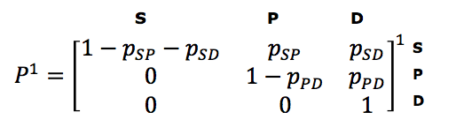
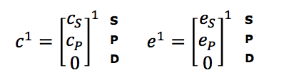
Matrix Implementation of the Markov Model
Transition probability matrix
Vector of cycle’s cost/outcomes
Notes:
Who is familiar with basic matrix calculations?
-> Inner product

Slide 78
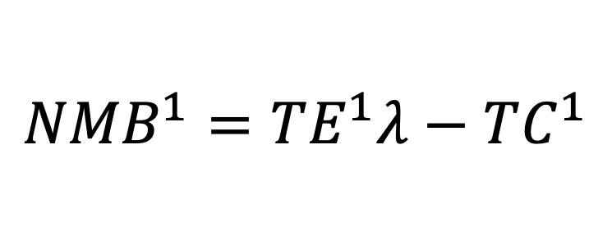
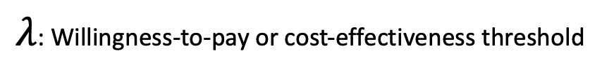
Calculating total costs & effects
E = M e
TE = ι_{T} E
Total effects (TE):
Total costs (TC):
Net Monetary Benefit (NMB):
1
1
1
1
C =M c
TC = ι_{T} C
1
1
1
1
$${NMB}^{1}=TE^{1}λ−TC^{1}$$
ι_{T} : 1 × T vector of ones
$λ$: Willingness-to-pay or cost-effectiveness threshold

Slide 79
Presenting the PSA results
TC
. (TE¹, TC¹)
0
TE

Slide 80
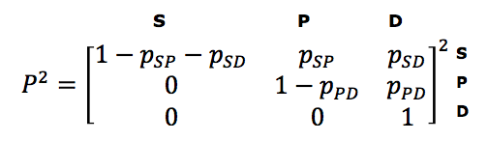
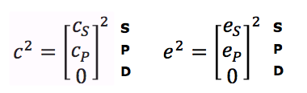
Matrix Implementation of the Markov Model
Transition probability matrix
Vector of cycle’s cost/outcomes
H S D
H
S
D
H
S
D
Notes:
Who is familiar with basic matrix calculations?
-> Inner product

Slide 81
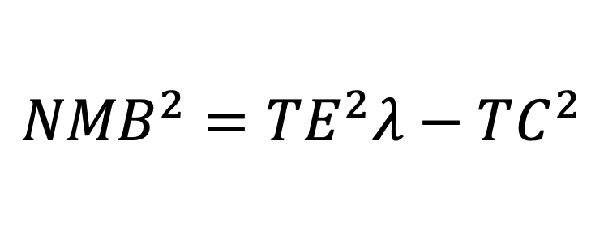
Calculating total costs & effects
E =M e
TE = ι_{T} E
Total effects (TE):
Total costs (TC):
Net Monetary Benefit (NMB):
2
2
2
2
2
C =M c
TC = ι_{T} C
2
2
2
2
2
$${NMB}^{2}=TE^{2}λ−TC^{2}$$
ι_{T} : 1 × T vector of ones
$λ$: Willingness-to-pay or cost-effectiveness threshold

Slide 82
Presenting the PSA results
TC
. (TE², TC²)
. (TE¹, TC¹)
0
TE

Slide 83
Presenting the PSA results
TC
.
.
.
.
.
.
.
.
.
.
.
.
.
.
.
.
.
.
.
.
.
.
.
.
.
.
.
.
.
.
.
.
.
.
.
.
.
.
.
.
.
.
.
.
.
.
.
.
.
.
.
.
.
.
.
.
.
.
.
.
.
.
.
.
.
.
.
.
.
.
.
.
.
.
.
.
.
.
.
.
.
.
.
.
.
.
.
.
.
.
.
.
.
.
.
.
.
.
.
.
.
.
.
.
.
.
.
.
.
.
.
.
.
.
.
.
.
.
.
.
.
.
.
.
.
.
.
.
.
.
.
.
.
.
.
.
.
.
.
.
.
.
.
.
.
.
.
.
.
.
.
.
.
.
.
.
.
.
.
.
.
.
.
.
.
.
.
.
.
.
.
.
.
.
.
.
.
.
.
.
.
.
.
.
.
.
.
.
.
.
.
.
.
.
.
.
.
.
.
.
.
.
.
.
.
.
.
.
.
.
.
.
.
.
.
.
.
.
.
.
.
.
.
.
.
.
.
.
.
.
.
.
.
.
.
.
.
.
.
.
.
.
.
.
.
.
.
.
.
.
.
.
.
.
.
.
.
.
.
.
.
.
.
.
.
.
.
.
.
.
.
.
.
.
.
.
.
.
.
.
.
.
.
.
.
.
.
.
.
.
.
.
.
.
.
.
.
.
.
.
.
.
.
.
.
.
.
.
.
.
.
.
.
.
.
.
.
.
.
.
.
.
.
.
.
.
.
.
.
.
.
.
.
.
.
.
.
.
.
.
.
.
.
.
.
.
.
.
.
.
.
.
.
.
.
.
.
.
.
.
.
.
.
.
.
.
.
.
.
.
.
.
.
.
.
.
.
.
.
.
.
.
.
.
.
.
.
.
.
.
.
.
.
.
.
.
.
.
.
.
.
.
.
.
.
.
.
.
.
.
.
.
.
.
.
.
.
.
.
.
.
.
.
.
.
.
.
.
.
.
.
.
.
.
.
.
.
.
.
.
.
.
.
.
.
.
.
.
.
.
.
.
.
.
.
.
.
.
.
.
.
.
.
.
.
.
.
.
.
.
.
.
.
.
.
.
.
.
.
.
.
.
.
.
.
.
.
.
.
.
.
.
.
.
.
.
.
.
.
.
.
.
.
.
.
.
.
.
.
.
.
.
.
.
.
.
.
.
.
.
.
.
.
.
.
.
.
.
.
.
.
.
.
.
.
.
.
.
.
.
.
.
.
.
.
.
.
.
.
.
.
.
.
.
.
.
.
.
.
.
.
.
.
.
.
.
.
.
.
.
.
.
.
.
.
.
.
.
.
.
.
.
.
.
.
.
.
.
.
.
.
.
.
.
.
.
.
.
.
.
.
.
.
.
.
.
.
.
.
.
.
.
.
.
.
.
.
.
.
.
.
.
.
.
.
.
.
.
.
.
.
.
.
.
.
.
.
.
.
.
.
.
.
.
.
.
.
.
.
.
.
.
.
.
.
.
.
.
.
.
.
.
.
.
.
.
.
.
.
.
.
.
.
.
.
.
.
.
.
.
.
.
.
.
.
.
.
.
.
.
.
.
.
.
.
.
.
.
.
.
.
.
.
.
.
.
.
.
.
.
.
.
.
.
.
.
.
.
.
.
.
.
.
.
.
.
.
.
.
.
.
.
.
.
.
.
.
.
.
.
.
.
.
.
.
.
.
.
.
.
.
.
.
.
.
.
.
.
.
.
.
.
.
.
.
.
.
.
.
.
.
.
.
.
.
.
.
.
.
.
.
.
.
.
.
.
.
.
.
.
.
.
.
.
.
.
.
.
.
.
.
.
.
.
.
.
.
.
.
.
.
.
.
.
.
.
.
.
.
.
.
.
.
.
.
.
.
.
.
.
.
.
.
.
.
.
.
.
.
.
.
.
.
.
.
.
0
TE

Slide 84
Example of a PSA dataset

Slide 85
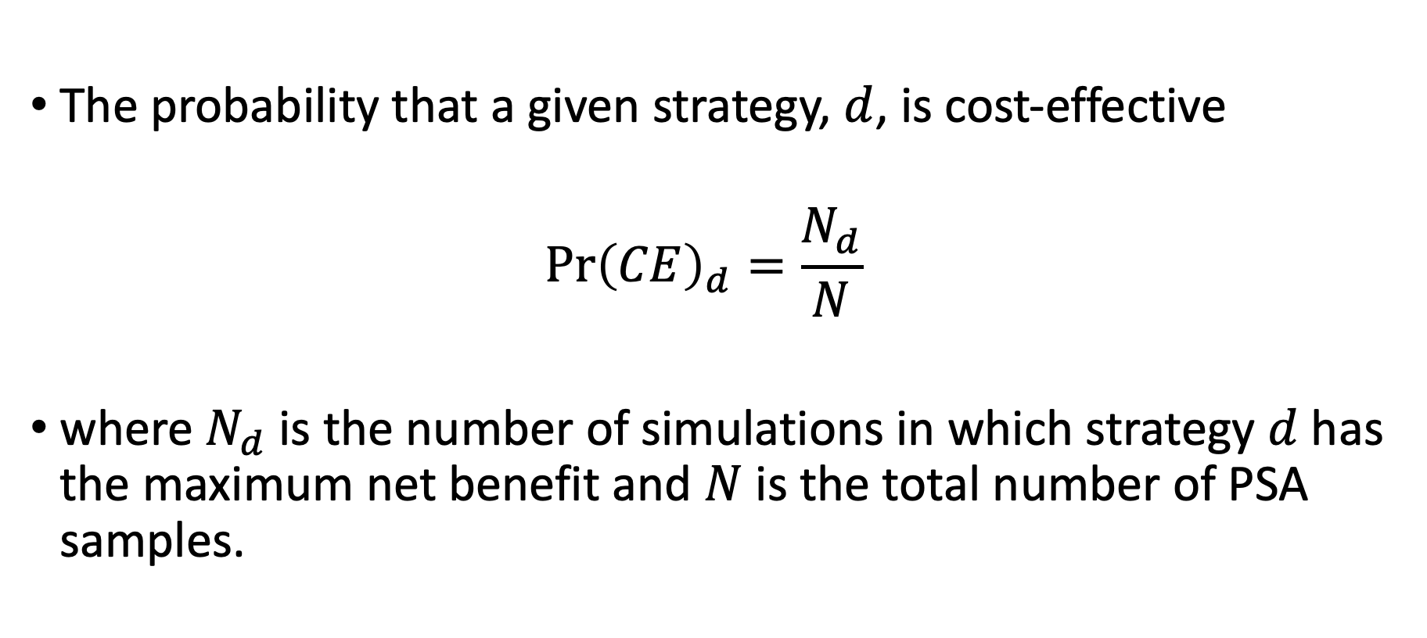
Decision Uncertainty
The probability that a given strategy, $d$, is cost-effective
$$\operatorname{Pr}{{\left(CE\right)}_{d}=\frac{N_{d}}{N}}$$
where $N_{d}$ is the number of simulations in which strategy $d$ has the maximum net benefit and $N$ is the total number of PSA samples.
Notes:
4

Slide 86
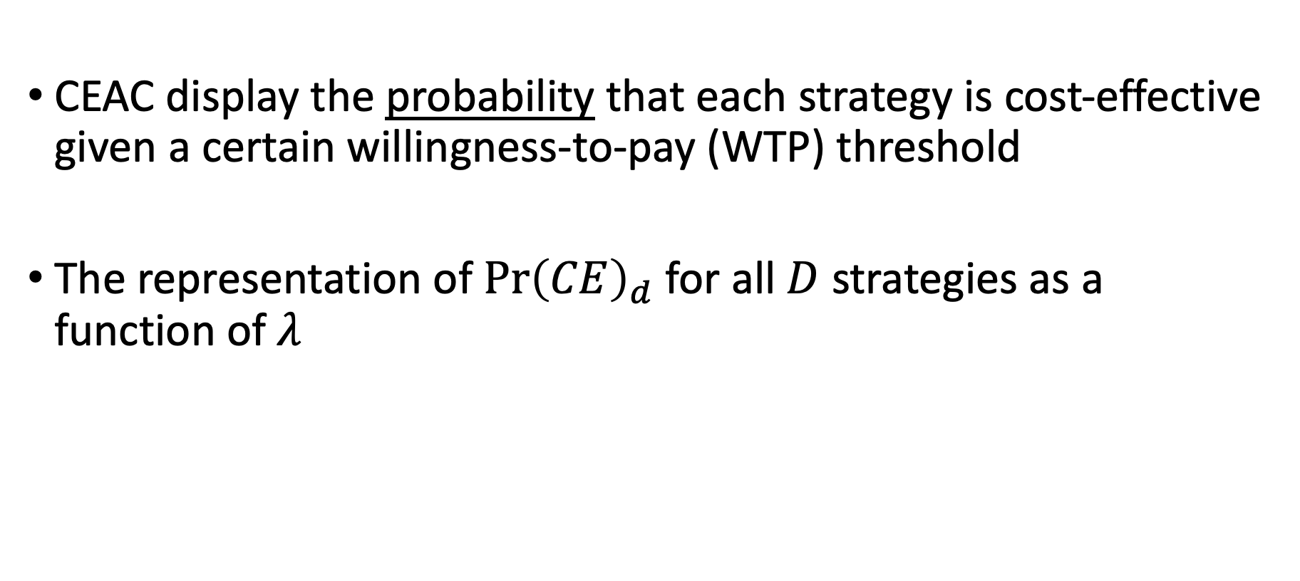
Cost-Effectiveness Acceptability Curves (CEAC)
CEAC display the probability that each strategy is cost-effective given a certain willingness-to-pay (WTP) threshold
The representation of $\operatorname{Pr}{{\left(CE\right)}_{d}}$ for all $D$ strategies as a function of $λ$
Notes:
4

Slide 87
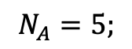
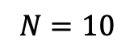
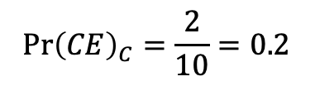
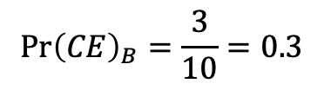
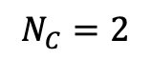
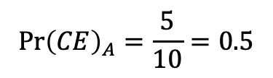
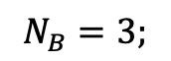
Construction of CEAC
$$N=10$$
$$N_{A}=5;$$
$$N_{B}=3;$$
$$N_{C}=2$$
$$\operatorname{Pr}{{\left(CE\right)}_{A}}=\frac{5}{10}=0.5$$
$$\operatorname{Pr}{{\left(CE\right)}_{B}}=\frac{3}{10}=0.3$$
$$\operatorname{Pr}{{\left(CE\right)}_{C}}=\frac{2}{10}=0.2$$
Highest probability

Slide 88
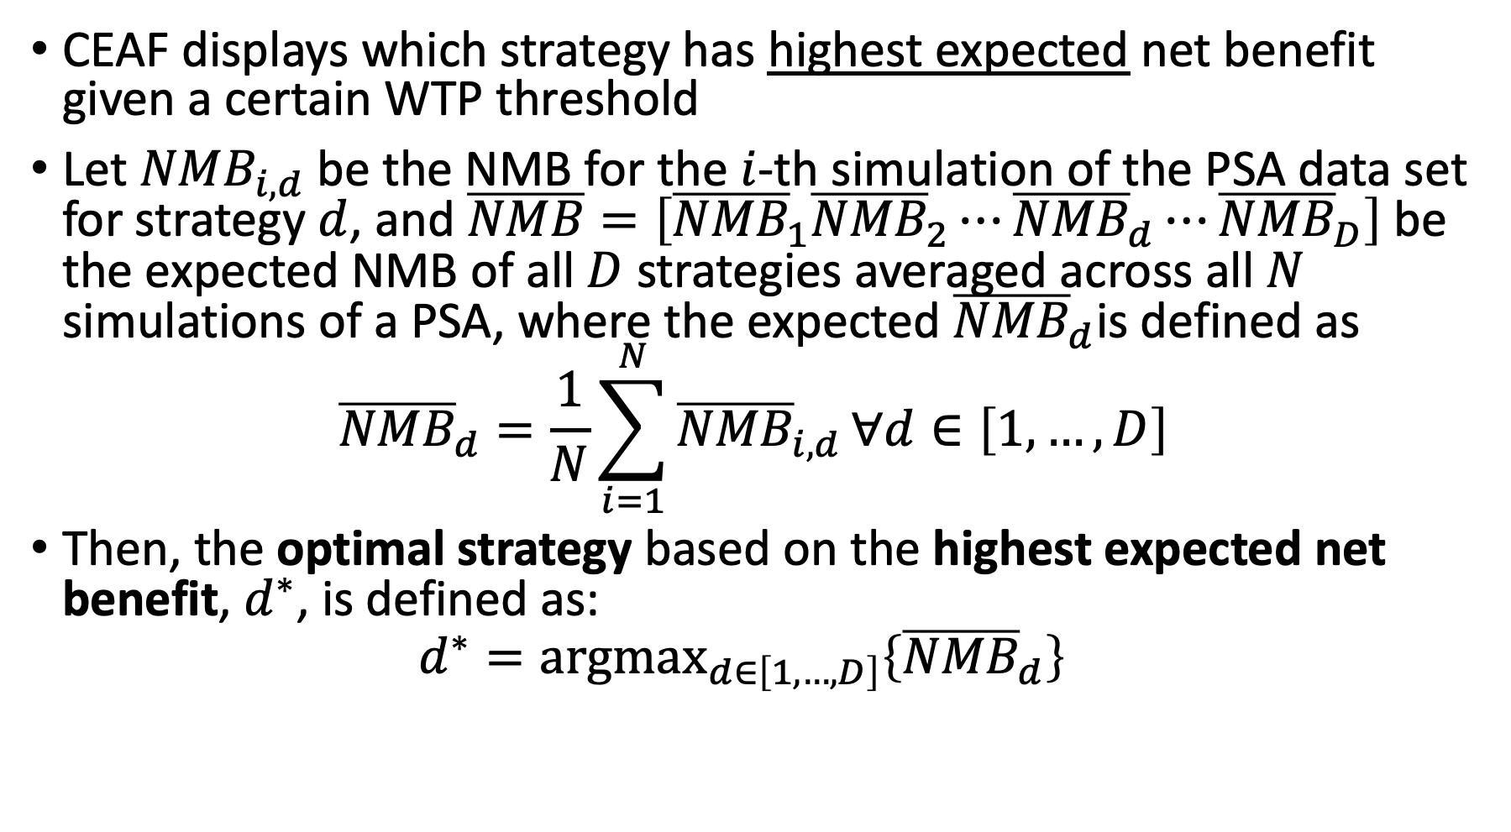
Cost-Effectiveness Acceptability Frontier (CEAF)
CEAF displays which strategy has highest expected net benefit given a certain WTP threshold
﻿Let ${NMB}_{i,d}$ be the NMB for the $i$-th simulation of the PSA data set for strategy $d$, and $\overline{NMB}=\left[{\overline{NMB}}_{1}{\overline{NMB}}_{2}⋯{\overline{NMB}}_{d}⋯{\overline{NMB}}_{D}\right]$be the expected NMB of all $D$ strategies averaged across all $N$ simulations of a PSA, where the expected ${\overline{NMB}}_{d}$is defined as
$${\overline{NMB}}_{d}=\frac{1}{N}\sum_{i=1}^{N}{{\overline{NMB}}_{i,d}}∀d∈\left[1,…,D\right]$$
Then, the optimal strategy based on the highest expected net benefit, $d^{∗}$, is defined as:
$$d^{∗}={\text{argmax}}_{d∈\left[1,…,D\right]}\left\{{\overline{NMB}}_{d}\right\}$$
Notes:
4

Slide 89
Construction of CEAF
Highest expected net benefit = Optimal strategy

Slide 90
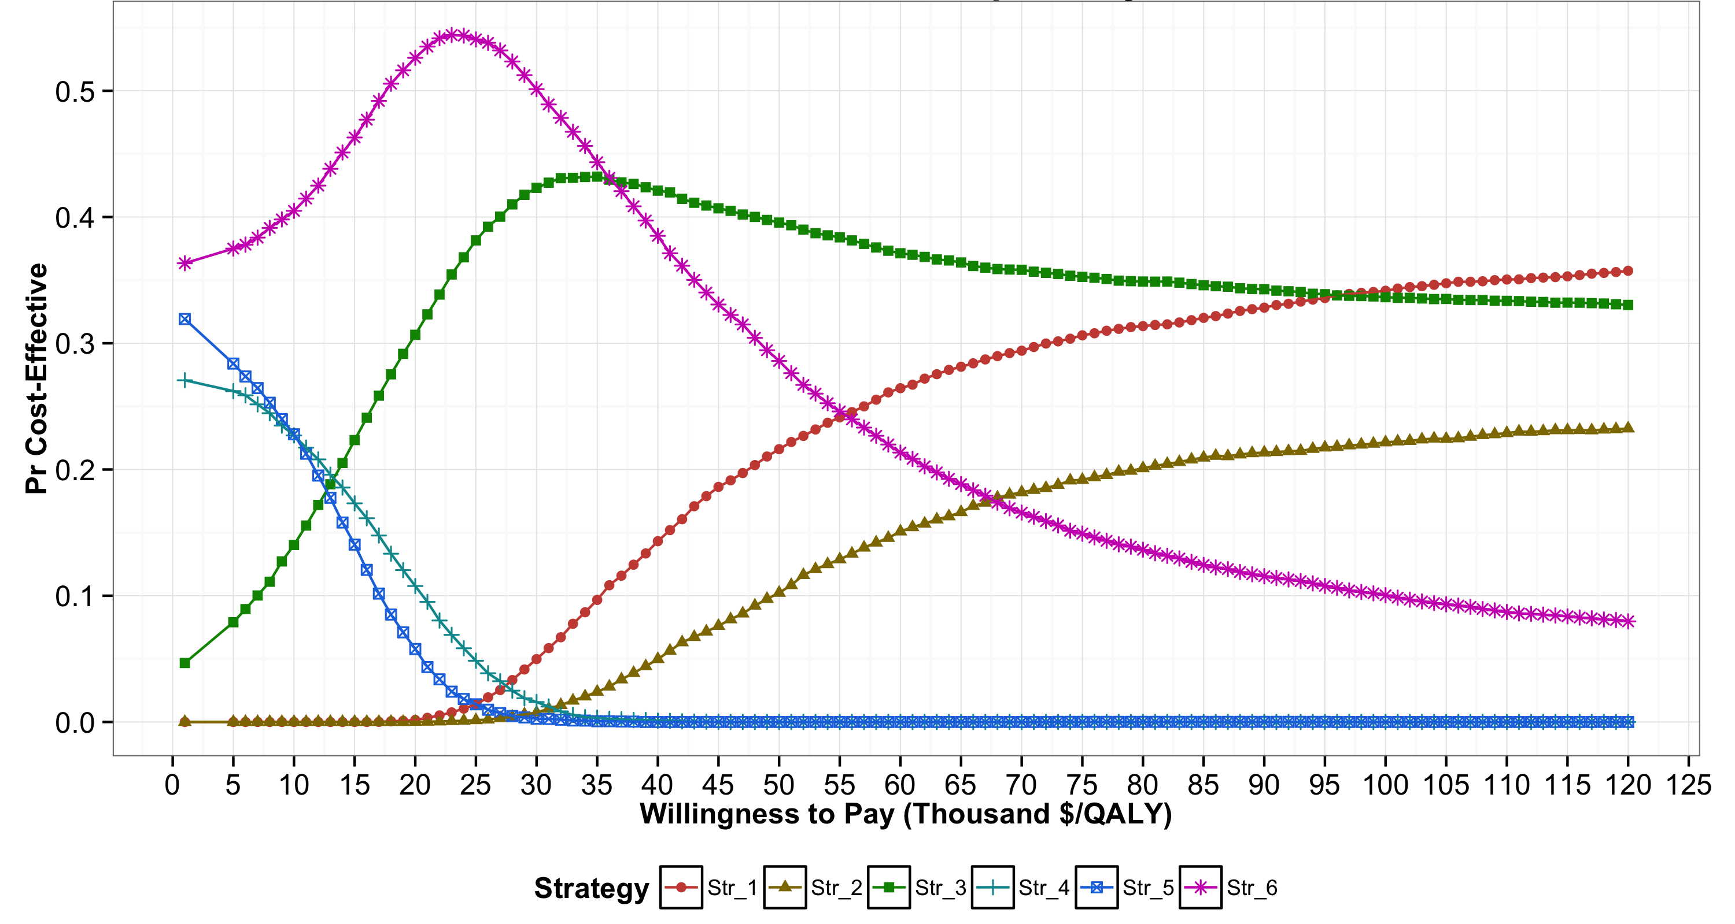
Cost-Effectiveness Acceptability Curves (CEACs)

Slide 91
Cost-Effectiveness Acceptability Curves (CEACs)

Slide 92
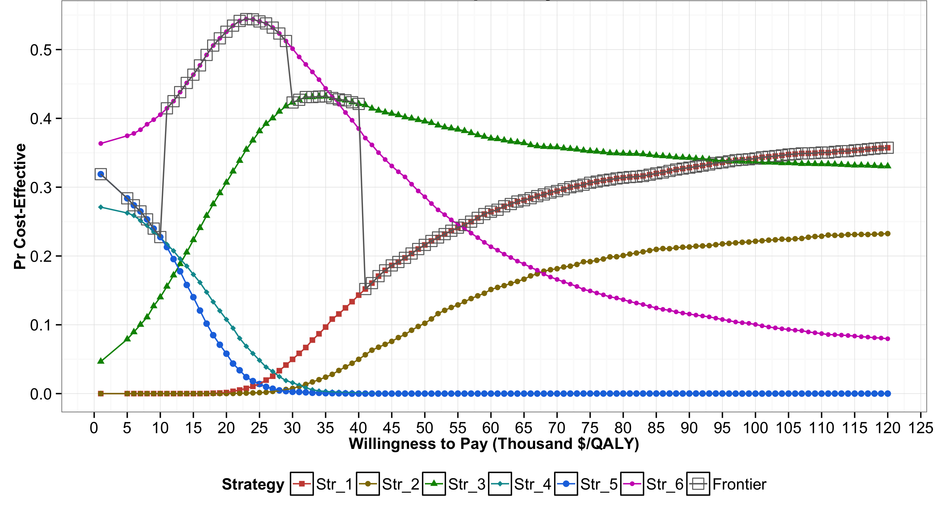
Cost-Effectiveness Acceptability Curves (CEACs) and Frontier (CEAF)

Slide 93
Cost-Effectiveness Acceptability Curves (CEACs) and Frontier (CEAF)

Slide 94
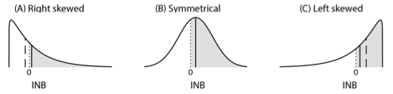
Distributions of Incremental NMB
Notes:
﻿The shaded area represents the probability of X being cost- effective compared to Y, which is the area under the curve to the right of INB = 0. The solid vertical line represents the expected INB of X vs. Y, and the dashed vertical line represents the median of the distribution of INB. X is optimal in all scenarios, but has the highest probability of being cost-effective only in scenarios B and C. In scenario B (i.e., symmetrical), the median and mean of INB coincide with each other.

Slide 95
Limitations of CEACs and CEAF
Only provide certain level of comfort in a decision but do not influence decision making
Not actual influence on policy recommendation
Could be misleading -> ﻿the strategy that is most likely to be cost-effective should not be conflated with the strategy that is optimal in expectation in the decision-making process
Notes:
4

Slide 96
Limitations of CEACs
Neither ﻿capture the magnitude of the net benefit lost in the proportion of PSA samples when chosen strategy is not cost-effective
﻿The expected loss in net benefits is truly the concern of the decision-maker because this represents the foregone benefits resulting from having chosen a given strategy
﻿Do not communicate the ordinal information in the ranking of the strategies by their expected benefits
Useful when implementing the optimal strategy is not feasible.
Notes:
4

Slide 97
Value of Information
How likely we are to make the wrong decision
And how bad it is to make the wrong decision
Cost of uncertainty (i.e., expected loss based on current information)
Expected benefit of potential future research
Can produce claims such as “How likely AND how bad?”

Slide 98
Expected Value of Perfect Information (EVPI)
Value of eliminating all sources of uncertainty for all parameters (𝜃)
Maximum willingness to pay to get perfect information on all parameters
No future data collection effort should exceed EVPI

Slide 99
Overcoming limitations of CEACs and CEAF
These limitations ﻿can be addressed by using expected loss curves (ELCs), previously proposed by others (Eckermann et al., 2008)
ELCs ﻿present a quantification of the consequences of choosing a suboptimal strategy in terms of expected foregone benefits as a function of WTP threshold
﻿ELCs also display the optimal strategy (like CEAF), the value of eliminating current level of decision uncertainty through additional research (like EVPI), and the ranking of strategies in terms of expected losses

Slide 100
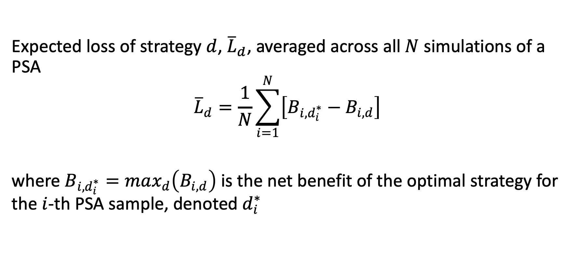
﻿Definition of expected losses
Expected loss of strategy $d$, ${\overline{L}}_{d}$, ﻿averaged across all $N$ simulations of a PSA
$${\overline{L}}_{d}=\frac{1}{N}\sum_{i=1}^{N}{\left[B_{i,d_{i}^{∗}}−B_{i,d}\right]}$$
where $B_{i,d_{i}^{∗}}=max_{d}\left(B_{i,d}\right)$ is the net benefit of the optimal strategy for the $i$-th PSA sample, denoted $d_{i}^{∗}$

Slide 101
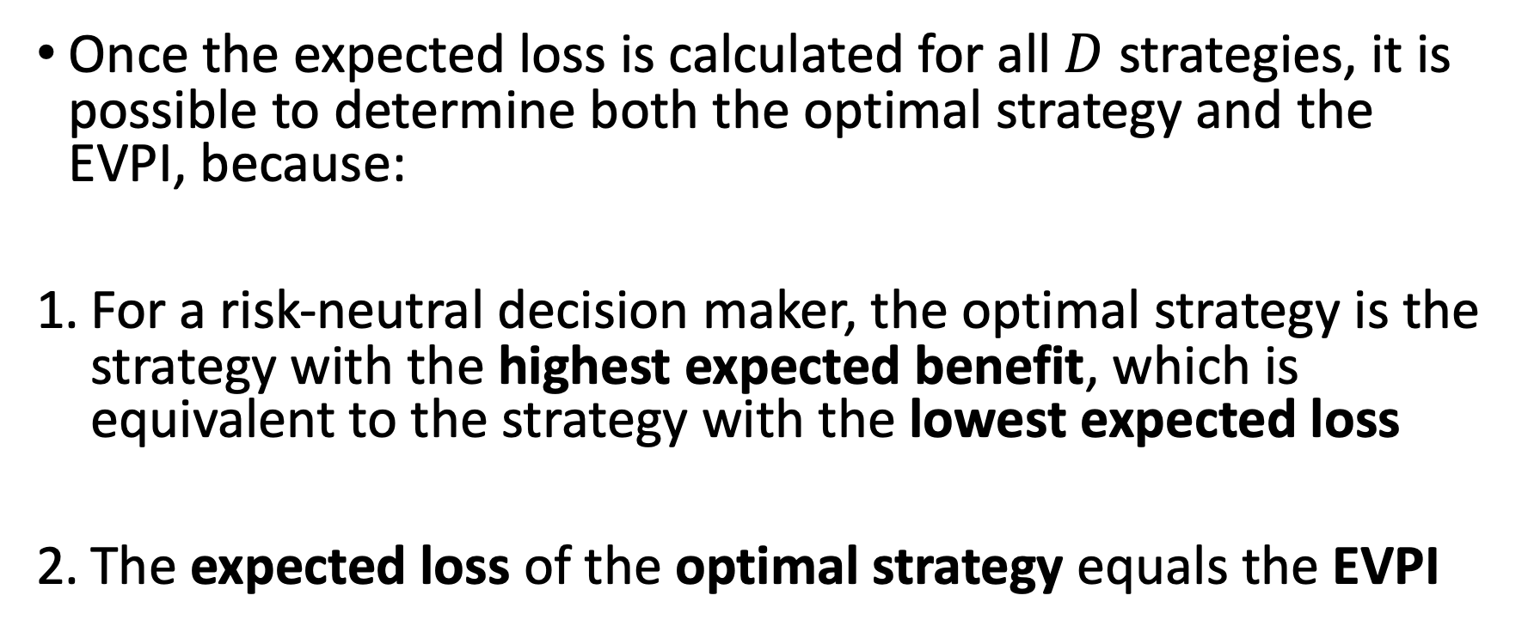
﻿Optimality criteria and VOI with expected losses
Once the expected loss is calculated for all $D$ strategies, it is possible to determine both the optimal strategy and the EVPI, because:
For a risk-neutral decision maker, the optimal strategy is the strategy with the highest expected benefit, which is equivalent to the strategy with the lowest expected loss
The expected loss of the optimal strategy equals the EVPI

Slide 102
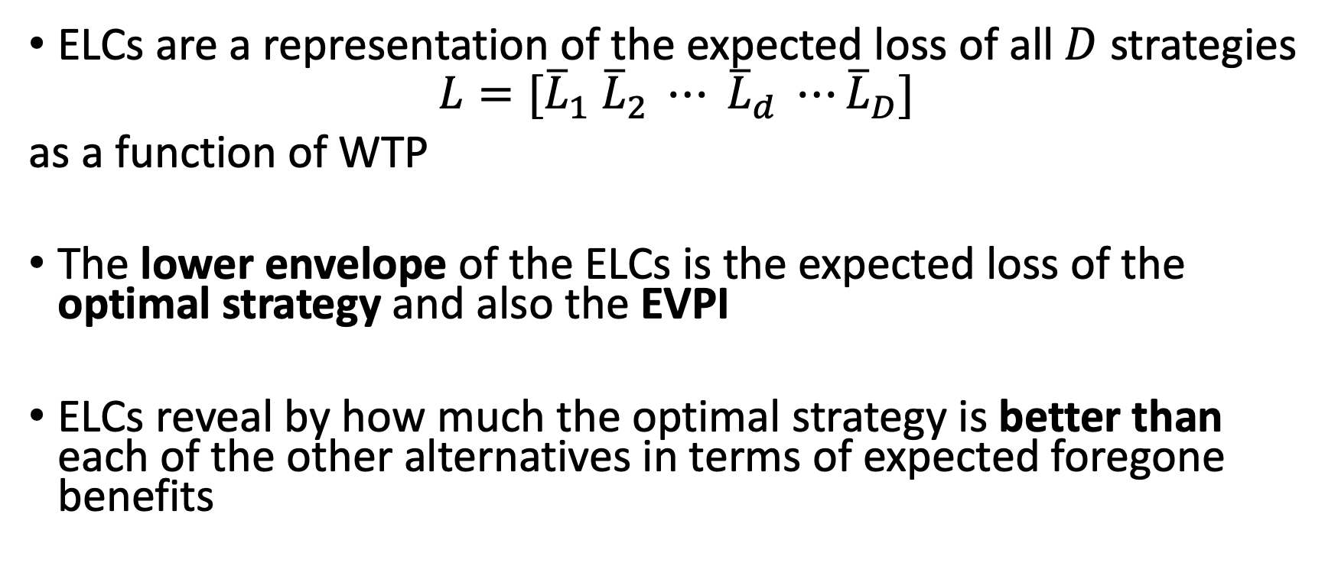
Expected Loss Curves (ELCs)
ELCs are a representation of the expected loss of all $D$ strategies
$$L=[{\overline{L}}_{1} {\overline{L}}_{2} ⋯ {\overline{L}}_{d} ⋯{\overline{L}}_{D}]$$
as a function of WTP
The lower envelope of the ELCs is the expected loss of the optimal strategy and also the EVPI
ELCs reveal by how much the optimal strategy is better than each of the other alternatives in terms of expected foregone benefits
Alarid-Escudero F, Enns EA, Kuntz KM, Michaud TL, Jalal H. “Time Traveling Is Just Too Dangerous” But Some Methods Are Worth Revisiting: The Advantages of Expected Loss Curves Over Cost-Effectiveness Acceptability Curves and Frontier. Value Health. 2019;22(5): ﻿611-618

Slide 103
Construction of ELCs
Lowest expected loss = Optimal strategy

Slide 104
CEACs and CEAF

Slide 105
CEACs and CEAF

Slide 106
ELCs

Slide 107
ELCs

Slide 108
EVPI

Slide 109
Which should I do?
Do OWSA/Thresholds to learn how your model responds (and to debug) for all parameters
Do a few MWSA to see how things interact (pick things that are influential/near influential on OWSA)
Do PSA b/c some journals require, b/c n-way deterministic analyses are impossible, to start to get at uncertainty (important caveats we have discussed)
Do Scenario Analyses: Clinically/Policy driven combinations of alternative parameters to ask what-if questions that are relevant – no claim about capturing uncertainty but easier to work into a narrative describing your analyses results in a way relevant to decision makers

Slide 110
How do I describe these?
Model-centric: “We varied model parameter p_complex_thing between 0.037 and 0.078 and found the ICER to fall from $68,224.4456 to $12,307.2380, showing that the model’s conclusions were sensitive to this value”
Policy-centric: “There is controversy about the true effectiveness of the intervention given that RCTs have found values as low as 0.037 and as high as 0.078. We assessed whether our main findings were sensitive to this range of values, finding that when effectiveness was high, the intervention’s cost per QALY gained fell from approximately $68,000 to just over $12,000, which is below conventionally used willingness to pay values for health, demonstrating that conclusions are sensitive to this value.”

Slide 111
Sage advice we have heard
Explore sensitivity/uncertainty in your model. It is as at least as important (if not more so) than the base case analysis

Slide 112
R session

